Slide 1

2026 HEALTH WEEK LECTURE
BY
Dr O. S. ADEKANYE (MB.Ch.B, FWACP (FM), JP)
LIFESTYLE MEDICINE: LIVING GOD’S DREAM FOR OUR HEALTH
APRIL, 2026

Slide 2
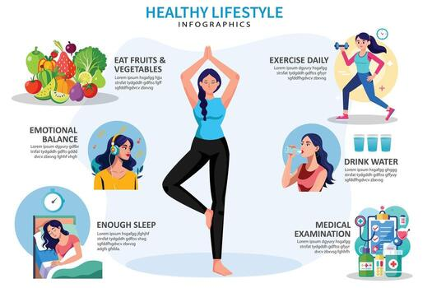
OUTLINE
INTRODUCTION
LIFESTYLE MEDICINE FRAME WORK
GOD’S ORIGINAL DESIGN FOR HEALTH
UNDERSTANDING THE DREAM FRAME WORK
HEALTH SEEKING BEHAVIOUR
A CALL TO RENEWAL
CONCLUSION
REFERENCE

Slide 3
INTRODUCTION
Lifestyle Medicine Is an essential bridge between “Living Long” and “Living well”. That is not just adding years to our lives; it is about adding life to our years.
It is a medical specialty that uses lifestyle interventions such as primarily nutrition, physical activity, sleep, stress management, tobacco cessation and social connection to prevent, treat and often reverse chronic disease
While Modern Medicine has mastered the art of Crisis management, patching wounds and managing symptoms. Life style Medicine represents a shift towards addressing the root causes of chronic diseases

Slide 4

INTRODUCTION CONTD.
LS: is a quiet realization that most powerful tools in a physician’s arsenal not found in pharmacy but in grocery store,local sport arenas/gyms and quality sleep.
It is an invitation to treat our bodies with respect they deserve not machine that breaks but as system capable of healing when given right condition
In the Christian tradition, we are reminded that our bodies are not our own – they are temples of the Holy Spirit. If we view our physical health through this lens, Lifestyle Medicine becomes the daily maintenance of that temple.
Nourishment as Grace
Rest as Obedience

Slide 5
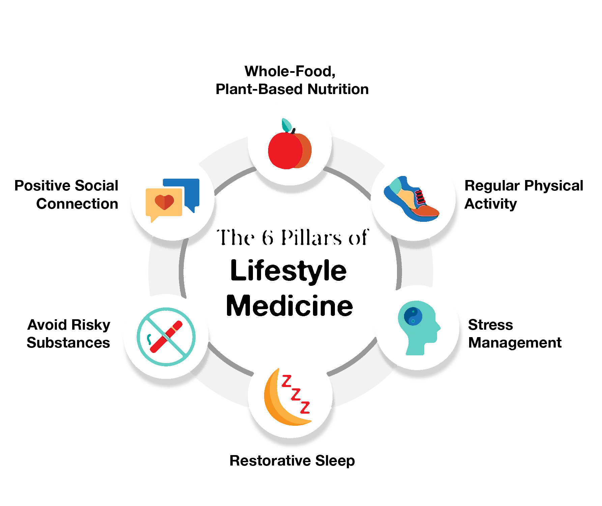
LIFESTYLE MEDICINE FRAMEWORK
This framework is simple but powerful:
D – Diet/Nutrition
R – Relationship
E – Exercise
A – Avoiding Harmful Substances
M – Mental well being
S – Sleep hygiene

Slide 6
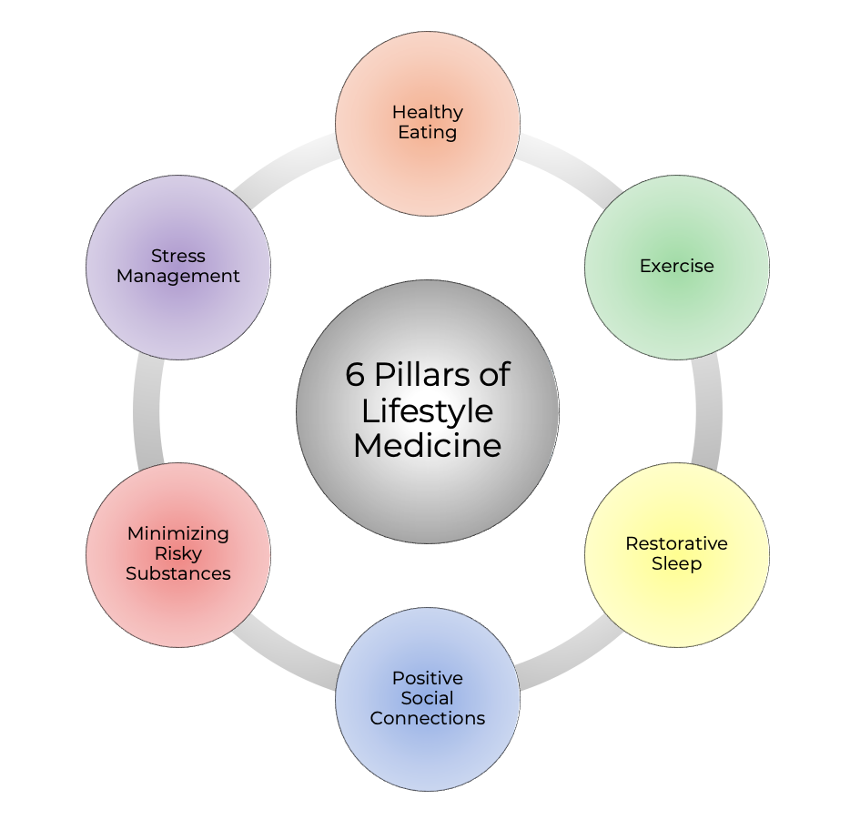
LIFESTYLE MEDICINE FRAMEWORK
Each of these pillars is a gift from God. Together, they make up a holistic way of living that blesses our bodies, strengthens our minds, and enriches our spiritual walk

Slide 7

Why Lifestyle Medicine?
In today’s world, many illnesses are not caused by infections but by the way we live. These are called lifestyle diseases
Life style diseases are:
Heart disease
High blood pressure
Diabetes
Obesity
Some cancers are strongly linked to poor diet, inactivity, stress, and harmful habits.

Slide 8
Why Lifestyle Medicine?
Lifestyle Medicine teaches us that through simple, God-honoring habits, we can prevent, manage, and even reverse many of these diseases
Science confirms what Scripture has always told us: “A cheerful heart is good medicine” (Proverbs 17:22)
When we align our lifestyle with God’s design, we not only gain physical health but also mental peace and spiritual strength.

Slide 9

God’s Original Design for Health
In Genesis, God created humankind and placed Adam and Eve in the Garden of Eden. There, He provided:
Nutritious food: (Genesis 1:29)
Meaningful activity
Rest: (Genesis 2:2–3)
Connection
Peace
These were God’s blueprint for health
Today, through the DREAMS framework, we are being invited to return to that divine plan.

Slide 10

Understanding the DREAMS Framework
Diet/Nutrition
Food is both a physical necessity and a spiritual symbol. Jesus Himself declared, “I am the bread of life” (John 6:35)
When we eat nourishing foods such as fruits, vegetables, whole grains, nuts, and legumes, we fuel our bodies to serve God and others. But when we consume too much processed food, sugar, and unhealthy fats, we weaken our temples.
A balanced diet is a form of gratitude and stewardship

Slide 11
HEALTHY EATING: A practical guide for everyday living
Food is one of the greatest gifts God has given us.
It nourishes our bodies, gives us energy to work and serve, and brings families and communities together.
However, the way we eat can either promote health and long life or contribute to illness and early death
A balanced diet simply means eating the right types of food, in the right amounts, and at the right times.

Slide 12
Why Healthy Eating Matters
Healthy eating is a powerful tool for body energy, building block,disease prevention and treatment. It is not about following a rigid “diet plan” but about developing a lifestyle that supports healthy living. Without good nutrition, people often experience:
Tiredness and lack of energy
Frequent infections
Slow healing from wounds or illness
Increased risk of long-term diseases like diabetes, stroke, and cancer

Slide 13
SOME Healthy Food Swaps
Instead of… (Less Healthy Habit) | Choose… (Healthier Local Option) | Why It’s Better
Soft drinks (Coke, Fanta, malt daily) | Water, unsweetened zobo, kunu without added sugar, coconut water | Cuts excess sugar → lowers risk of diabetes and weight gain
White bread with sugary spread | Whole wheat bread with groundnut paste, egg, or avocado | More fiber and protein → keeps you full longer
Large portions of white rice alone | Smaller rice portion + beans, moi-moi, or vegetables | Better blood sugar control and more nutrients
Instead of… (Less Healthy Habit) | Choose… (Healthier Local Option) | Why It’s Better
Soft drinks (Coke, Fanta, malt daily) | Water, unsweetened zobo, kunu without added sugar, coconut water | Cuts excess sugar → lowers risk of diabetes and weight gain
White bread with sugary spread | Whole wheat bread with groundnut paste, egg, or avocado | More fiber and protein → keeps you full longer
Large portions of white rice alone | Smaller rice portion + beans, moi-moi, or vegetables | Better blood sugar control and more nutrients

Slide 14
Some Healthy Food Swaps
Instead of… (Less Healthy Habit) | Choose… (Healthier Local Option) | Why It’s Better
Large portions of white rice alone | Smaller rice portion + beans, moi-moi, or vegetables | Better blood sugar control and more nutrients
Fried snacks (puff-puff, buns, chin-chin often) | Roasted corn, boiled groundnuts, garden eggs, fruits | Less unhealthy fat, more vitamins and fiber
Processed meats (sausages, corned beef, bacon) | Fresh fish, eggs, beans, lentils | Lower salt and preservatives

Slide 15
A Balanced Nigerian Meal Plate
Food Group | Local Examples | Portion Guide | Health Benefit
Vegetables | Ugu, efo, okra, bitter leaf, cabbage, carrot, green beans | ½ of the plate | Prevents constipation, heart disease, and some cancers
Fruits | Orange, banana, pawpaw, mango, pineapple, watermelon, guava | 1–2 servings daily | Boosts immunity, provides vitamins and fiber
Whole Grains / Starchy Foods | Ofada rice, brown rice, corn, millet, sorghum, unripe plantain, oats | ¼ of the plate | Provides steady energy and supports digestion

Slide 16
Healthy Eating Habits Beyond Food Choices
What we eat is important Eat varieties of foods, more plant base food and limit processed food (e.g high sugar, salt and unhealthy fats)
but how we eat also matters:
Meal timing :Avoid skipping meals and then over eating later
Portion control :Eat moderate portions,you can use smaller plate if necessary
Eating environment:Eat with family at a table and not infront of TV or phone
Water :Drink enough clean water daily instead of sweetened drinks
Gradual change: Start small-one healthy swap at a time e.g replace white bread with whole wheat,soft drink with water

Slide 17

Understanding the DREAMS Framework
Relationship Making Positive and health Social Connections.
God created us to live in relationship Gen.2:18 it is not good for man to be alone
God created us for fellowship. Hebrews 10:24–25 reminds us: “Let us not give up meeting together… but encourage one another.” Social connections bring encouragement, accountability, and joy.
Loneliness and broken relationships harm both the body and the spirit. Positive relationships are medicine for the soul

Slide 18
POSITIVE AND HEALTHY SOCIAL CONNECTIONS
Goes beyond casual greetings; it is about building trust, sharing joy and pain, and knowing you are not alone.
Positive connections are relationships that encourage, support, and uplift us.
Negative connections drain us, increase stress, or promote harmful behaviors.
Studies show that being socially isolated feels to the brain almost the same as physical pain
That is why loneliness can be so damaging

Slide 19
HOW SOCIAL CONNECTIONS AFFECT OUR HEALTH
Longevity and Happiness –Research has shown that the single most important predictor of happiness and long life is not wealth,fame,or career success,but the quality of relationship.
Mental health —Positive connections reduces stress,anxiety,and depression,they give us emotional support during tough times making us more resilent whereas,loneliness is linked to depression,poor self-esteem and suicidal tendencies.
Physical Health —Good connections activate parasympathetic nervous system which calms body and reduces harmful stress hormones.lsolation and stress increases inflammation and accelerates aging and contribute to disease like diabetes and cancer.
Purpose and Fulfillment – Meaningful relationship gives sense of purpose. Studies as shown that older adult with strong social ties and clear purpose are less likely to develop stroke, Alzheimer’s and heart disease.

Slide 20
The Role of Social Media
While social media can connect us across distances, it can also harm well being if overused or misused.
Studies show that excessive social media use is linked to higher rates of depression, anxiety, poor sleep, and low self-esteem, especially among young people
Tip: Use social media wisely. Prioritize face-to-face interactions and authentic conversations over “likes” and scrolling

Slide 21
Practical ways to build positive social connection
Strengthen family bonds,put away phones when engaging with others
Eat meals together regularly
Pray and worship together as a family
Resolve conflict quickly and peacfully,show empathy and kindness in conversations
NURTURE FRIENDSHIP
Check on friend regularly,not only in time of crisis
Celebrate their success and support them in challenges
Be intentional about spending time together.
PRACTICE FORGIVENSS
Let go off grudges-they harm relationship and health
Express thanks often; gratitude strengthens connections

Slide 22
Understanding the DREAMS Framework
Physical Exercise
Our bodies were created for movement. Physical activity is not just about fitness—it is about strength for service. Paul says in 1 Timothy 4:8 “For physical training is of some value, but godliness has value for all things.”
Walking, running, dancing, or playing with children—all are forms of exercise that keep the heart strong, the mind sharp, and the spirit joyful.
Regular movement is one way we prepare ourselves to be effective workers in God’s vineyard.

Slide 23
Physical Exercise
Just as a house needs regular care to remain strong, our bodies also need maintenance
One of the most powerful tools for maintaining health is PHYSICAL EXERCISE
In today’s world, many diseases such as diabetes, high blood pressure, heart disease, and obesity are linked to a lack of physical activity

Slide 24
PHYSICAL FITNESS
Being physically fit means having the ability to perform daily activities with energy and alertness, without feeling overly tired, and still having strength left for leisure and emergencies
There are two categories of fitness:
Health-related fitness: Cardiorespiratory endurance, muscular strength, muscular endurance, flexibility, and healthy body composition
Skill/Athletic fitness: Skills like speed, agility, power, and coordination

Slide 25
How Much Exercise Do We Need?
Health experts recommend:
Adults (18 - 60years): At least 150–300 minutes per week of moderate exercise (like brisk walking) or 75–150 minutes of vigorous exercise (like jogging)
Muscle strengthening: At least 2 days per week for all major muscle groups
Older adults (above 60 years): Include balance exercises (e.g., standing on one foot)
A simple way to monitor exercise intensity is by heart rate. Maximum heart rate is roughly 220 minus age. Working at 50–70% of that is considered moderate intensity

Slide 26
Benefits of Physical Exercise
Exercise is truly medicine, it benefits every part of the body. Some of the benefits are thus:
It improve Cardiovascular Health
Help in weight control and improves metabolism
Help in Cancer Prevention
Brain and Mental Health
Bone and Muscle Health
Longevity and Quality of Life

Slide 27
FAITH AND EXERCISE
Our faith can motivate us to care for our bodies. Just as Paul said, “physical training is of some value” (1 Timothy 4:8), exercise helps us stay strong for service, family, and God’s work
It improves energy for worship, ministry, and daily life
The message is simple: Move more, sit less, be consistent. Even small steps, done regularly, bring great rewards

Slide 28
Understanding the DREAMS Framework
Avoiding Harmful Substances
Scripture is clear: “Do not get drunk on wine, which leads to debauchery. Instead, be filled with the Spirit” (Ephesians 5:18)
Substances such as alcohol, tobacco, and drugs damage the body, cloud judgment, and separate us from God’s holiness
When we avoid harmful substances, we choose sobriety, clarity, and freedom. We also set a godly example for our children and communities

Slide 29
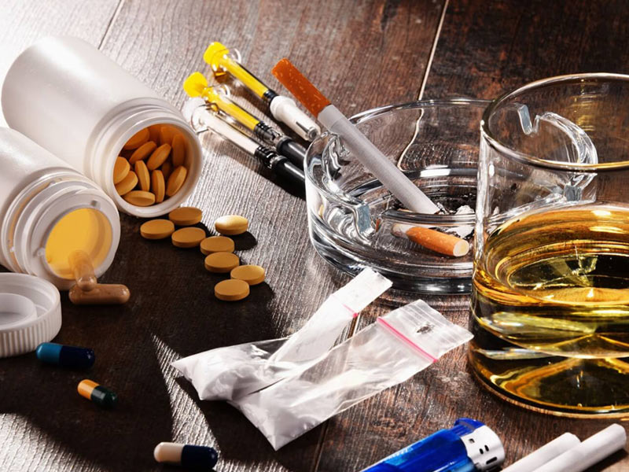
Reasons for Harmful Substances Abuse
Understanding the reasons helps us provide better support
Peer pressure, especially among youths
Stress, anxiety, or depression
Curiosity and experimentation
Family or community acceptance (e.g., alcohol in celebrations)
Media influence and advertising

Slide 30
THE IMPACT ON FAMILIES AND COMMUNITIES
Risky/harmful substance use does not only harm the individual. It also:
Destroys marriages and families.
Increases road traffic accidents.
Wastes family income.
Fuels crime, violence, and insecurity in communities.
Creates generational cycles of poverty and addiction

Slide 31
Practical Steps to Avoid Risky Substances
Prevention is better than cure
Say “no” to the first cigarette, drink, or pill
Teach children early about the dangers
Replace risky habits with healthy ones
Exercise, prayer, music, or hobbies to manage stress.
Choose positive friends who live healthy lives
Seek support if already using
Speak to a doctor or counselor
Join support groups like Alcoholics Anonymous (AA)
Lean on faith and community for encouragement.

Slide 32
Church and Community Role
As God’s people, we are called to care for our bodies and set examples for others and;
Educate members, especially youths, on dangers.
Provide safe spaces for recreation and fellowship.
Offer counseling, mentoring, and rehabilitation support
As 1 Corinthians 10:23 says, “Everything is permissible—but not everything is beneficial. Everything is permissible—but not everything is constructive.

Slide 33
Understanding the DREAMS Framework
Mental well being (Stress Management)
Stress is the body’s response to any demand or challenge. It can come from work, family, finances, health problems, or even our thoughts.
Scientists describe stress as both physiological (how the body reacts) and psychological (how the mind and emotions react) (Schneiderman et al., 2005).

Slide 34
Mental well being (Stress Management)
There are two sides to stress:
Positive stress (eustress): This gives energy, focus, and motivation. For example, preparing for an exam, planning a wedding, or getting ready for a presentation can push us to perform well
Negative stress (distress): This overwhelms us, causes worry, poor health, and loss of peace. If it continues for too long, it becomes harmful.

Slide 35
Types of Stress
Stress can take many forms (Adefemi,2025):
Acute stress
Episodic acute stress
Chronic stress
Traumatic stress
Psychological stress
Environmental stress
Work-relatedstress
Social stress
Financial stress
Physiological stress.

Slide 36
HOW STRESS AFFECTS THE BODY AND MIND
When the brain perceives danger, it triggers a fight/ flight response.
Body releases adrenaline and cortisol making the heart beat faster ,blood pressure rises,muscle tenses.
This reaction is helpful for emergency but causes harm after a long time.
EFFECT OF CHRONIC STRESS
Physical problems e.g headache,high blood pressure stomach upset,poor sleep.
Emotional problems e.g irritability,anger,sadness, or hopelessness.
Mental problems e.g poor concentration,memory loss,confusion

Slide 37
EFFECT OF CHRONIC STRESS
Physical problems e.g headache,high blood pressure stomach upset,poor sleep.
Emotional problems e.g irritability,anger,sadness, or hopelessness.
Mental problems e.g poor concentration,memory loss,confusion
Behavioral problem e.g overeacting,smoking,alcohol use,withdrawal from people
Social problem e.g conflict with family,friends or co-workers

Slide 38
STRATEGIES FOR STRESS MANAGEMENT
Physical strategies—exercise regularly,eat healthy meals,sleep well e.t.c
Mental strategies—think positively,mindfulness and meditation.
Emotional and social strategies—talk to other, laughter and joy, seek help, express emotion
Spiritual strategies—prayer and meditation, worship, rest in faith, purpose and value

Slide 39
Faith and Stress Management
Faith plays a powerful role in managing stress. Studies show that spiritual practices like prayer and worship improve resilience and bring peace (WHO 2023).
For Christians, God’s word provides comfort:
“Do not be anxious about anything, but in every situation, by prayer and petition, with thanksgiving, present your requests to God” (Philippians 4:6–7).
“Come to me, all you who are weary and burdened, and I will give you rest” (Matthew 11:28).
Trusting God does not mean ignoring practical steps for health, but combining faith with wise choices gives strength to overcome stress.

Slide 40
Faith and Stress Management
Life is full of challenges, but God does not want us to be consumed by worry. Jesus said in John 16:33: “In this world you will have trouble. But take heart! I have overcome the world.”
Stress damages health, but peace in Christ restores it. Through prayer, worship, exercise, rest, and community support, we can manage stress in ways that glorify God. When we cast our cares on Him (1 Peter 5:7), He gives us peace beyond understanding.

Slide 41
Understanding the DREAMS Framework
Sleep hygiene (Adequate Restorative Sleep)
Sleep is not laziness—it is obedience to God’s design. Psalm 127:2 says: “He gives sleep to those He loves.”
In our busy world, many neglect sleep, but chronic exhaustion leads to poor health, weakened faith, and strained relationships. By prioritizing rest, we align with God’s rhythm of work and renewal.

Slide 42
SLEEP HYGIENE (Adequate Restorative Sleep)
Sleep is one of the most precious gifts of God. Every living creature needs sleep, but for human beings, it is more than just a period of rest—it is a time when the body heals, the mind resets, and the soul regains peace.
The Psalmist reminds us: “In peace I will lie down and sleep, for you alone, Lord, make me dwell in safety” (Psalm 4:8).
Sleep can be defined as naturally recurring state of rest for the mind and body.
It is marked by reduced awareness, decreased muscle activity and limited interaction with the environment

Slide 43
THE SCIENCE OF SLEEP
Sleep happen in a cycles of about 90 minutes,repeating 4-6 times a night.
NON RAPID EYE MOVEMENT(NREM)SLEEP
Stage 1: Transition between wakefulness and sleep(light sleep)
Stage 2: True sleep begins:body temperature drops
Stage 3 and 4: Deep sleep(slow wave sleep).This is the most restorative phase where tissue repair and hormone release occur.

Slide 44
RAPID EYE MOVEMENT SLEEP(REM)SLEEP
Occur after sleep
Brain become very active,dream occur ,and emotional processing happens
Help with memory,creativity and learning.
A healthy night alternate between NREM and REM. Missing deep NREM sleep deprives the body of healing , while missing REM sleep affects memory and emotions

Slide 45
WHAT IS RESTORATIVE SLEEP?
Restorative sleep is a specific stage of sleep, often called “deep sleep” or “slow-wave sleep,” that brings the greatest healing.
During this stage, the brain waves slow down, muscles fully relax, and the body undergoes powerful recovery processes:
Tissue repair and muscle growth
Release of growth hormones
Strengthening of the immune system
Consolidation of memories and learning
Without restorative sleep, even long hours in bed may leave you feeling tired.

Slide 46
How Much Sleep Do We Need?
The American Academy of Sleep Medicine provides the following recommendations:
Children (6–12 years): 9–12 hours per night
Teenagers (13–18 years): 8–10 hours per night
Adults (18–60 years): at least 7 hours per night
Older adults (61+ years): 7–8 hours per night

Slide 47
CONSEQUENCES OF POOR SLEEP
When sleep is short or disrupted ,the whole body suffers. Some of the consequences are:
Physical Health: Type2 DM, Heart Disease, Obesity, Cancer
Mental Health: Depression, Anxiety, Bipolar disorder and even PTSD.
Hormones and Reproduction: Lower testosterone in men, Growth hormone level drops
Public Safety: RTA, Medical errors

Slide 48
STRATEGIES FOR RESTORATIVE SLEEP
Some of the strategies for restorative sleep are:
Create the right environment
Establish a regular routine
Be physically and socially active
Watch diet and substances : avoid alcohol, caffein, energy drink and heavy meal before bed
Manage stress spiritually and emotionally
Short term aids

Slide 49
Health-Seeking Behaviour: A Lifestyle That Protects Life and Honours God
Health‑seeking Behavior is the deliberate actions individuals and families take to prevent illness, detect disease early, and seek appropriate care when needed.
It reflects wisdom, responsibility, and stewardship of the body God has given us
Proverbs 4:7 reminds us, “Wisdom is the principal thing; therefore get wisdom.”

Slide 50
Health‑seeking Behaviour…..
Health‑seeking behaviour refers to how people:
Recognize symptoms of illness
Decide when and where to seek help
Use preventive health services
Adhere to medical advice and follow‑up care

Slide 51
Components of Health-Seeking Behaviour
Regular Wellness Checks
Early Presentation to Healthcare Facilities
Vaccination Uptake
Cancer Screening
Health Insurance Enrollment e.t.c

Slide 52
Why This Matters for the Church
Why should we, as a church, pay attention to Lifestyle Medicine and the DREAM framework? Because:
Our mission depends on it
A sick church cannot be a strong witness
A weary congregation cannot serve effectively
An unhealthy body cannot fully worship with joy

Slide 53
A Call to Renewal
As we begin this journey, let us each ask ourselves:
What one change can I make this week?
Can I eat more fruits and vegetables?
Can I sleep a little earlier?
Can I walk more and sit less?
Can I cut back on harmful habits?
Can I reach out to a friend or join a fellowship group?
Can I replace worry with prayer?
Small steps, done faithfully, bring lasting change

Slide 54
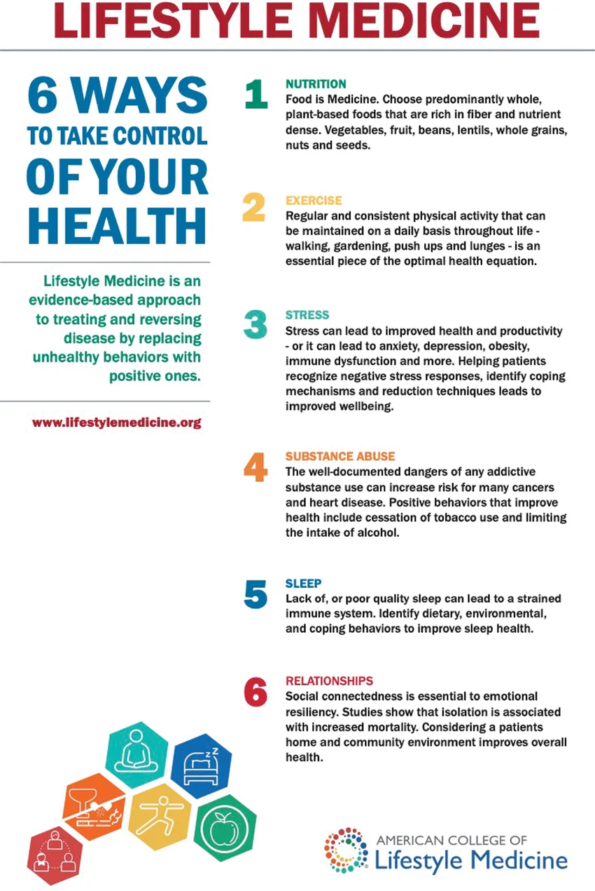

Slide 55
CONCLUSION
As we conclude, I invite you to make a commitment today—not just to hear this message but to live it. Lifestyle change is not easy, but with God’s help, it is possible.
Start with one step. Maybe it is drinking more water instead of soda. Maybe it is going to bed earlier, taking a walk after dinner, reducing alcohol, calling a friend, or praying instead of worrying. Small steps, done faithfully, lead to transformation.

Slide 56
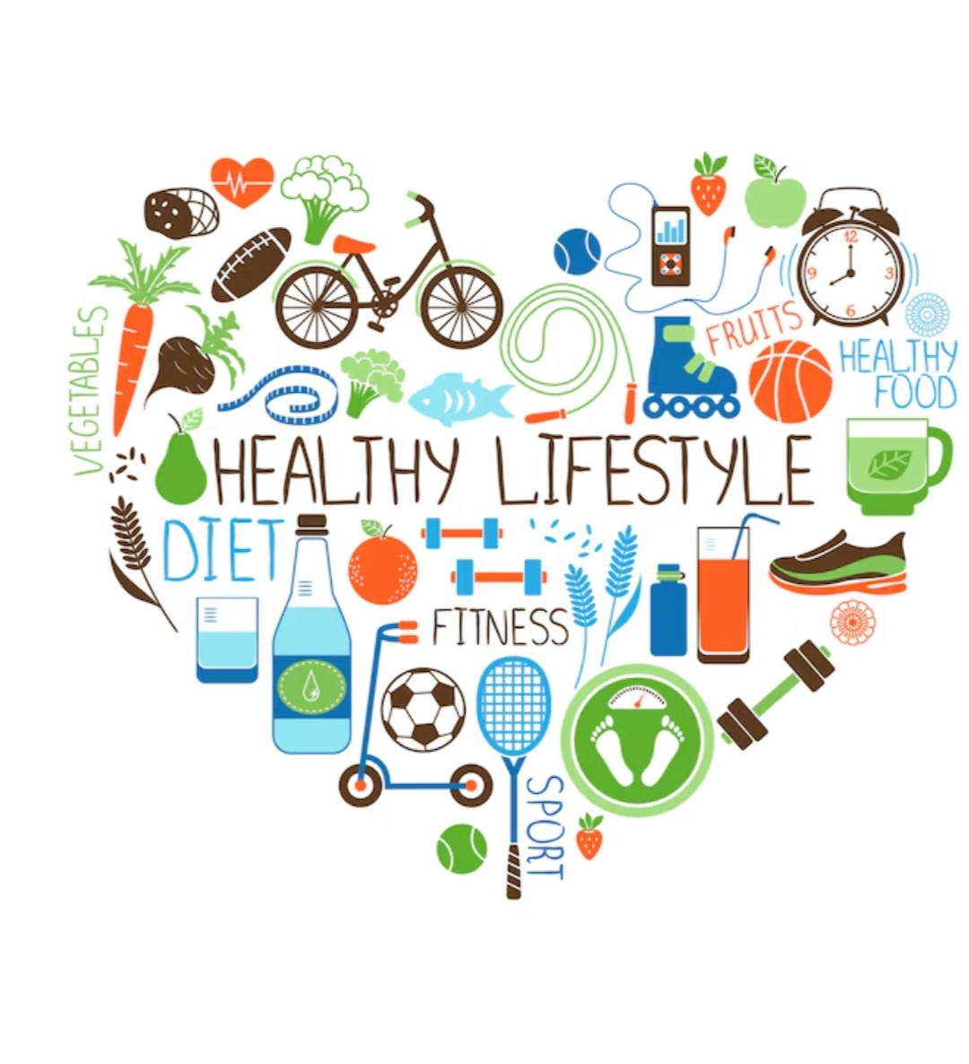
CONCLUSION
Together, as a church, let us encourage one another. Let us be accountable, share testimonies, and celebrate victories. In doing so, we will not only improve our health but also strengthen our witness for Christ.

Slide 57

May our diet honor Him!!!!
May our sleep refresh us!!!
May our exercise strengthen us!!!
May our choices keep us holy!!!
May our relationships reflect His love!!!
May our peace reveal His presence!!!
Let us live the DREAMS lifestyle

Slide 58
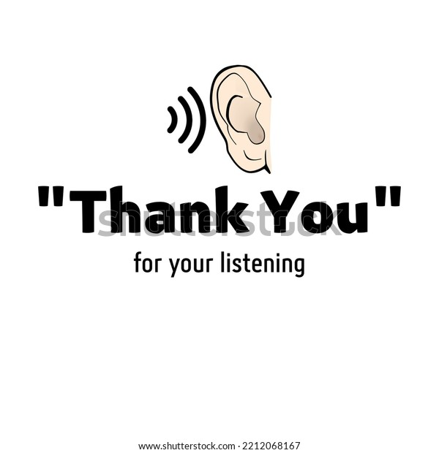

Slide 59
REFERENCES
American College of Lifestyle Medicine. Lifestyle Medicine Core Pillars. ACLM.
Harvard T.H. Chan School of Public Health. Healthy Eating Plate.
Holt-Lunstad J, et al. Social relationships and mortality risk. PLoS Medicine.
American College of Sports Medicine. Exercise Guidelines. 2021.
UNODC. World Drug Report. United Nations.
Shanafelt TD, et al. Burnout and work-life balance. Mayo Clinic Proceedings. 2015.
Harvard Medical School. Healthy sleep overview.
World Health Organization (WHO).
Delays in seeking healthcare and their impact on health outcomes. WHO.

